Slide 1
Real Estate -ROI
Tapping the U.S. Real Estate Market for the best ROI
Jon Kearney
Wilson Quizhpi
Latoya Springer

Slide 2
Market Opportunity
Questions to be answered
Which cities in the United States offer best ROI for purchasing rental properties considering home purchase value and rental value?
Historically, how have these cities performed. How have they faired in the last 1, 3 and 5 years in terms of ROI?
Looking into the future, which cities offer the best outlook on their ROI?

Slide 3
Data Cleanup & Exploration
Challenge 1
Challenge 2
Challenge 3
Finding Data
Limited free data for Real Estate Investors
Big Data
Narrowing down data.
Data formatting
Categorical data
Merging

Slide 4
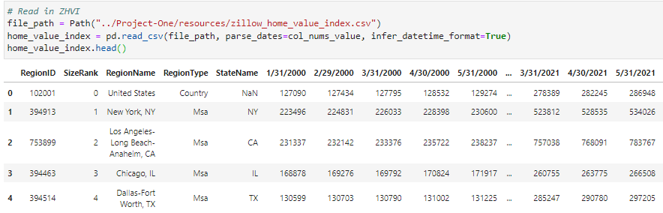
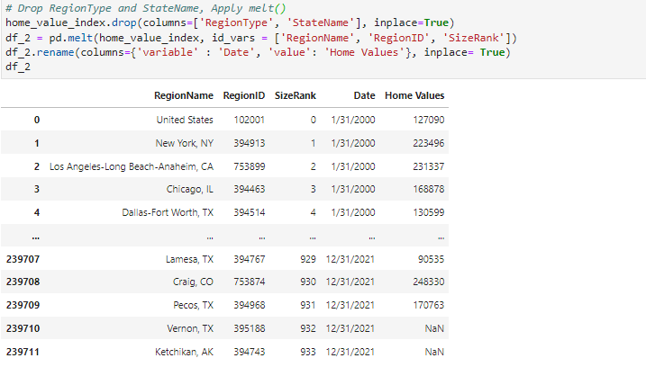
Data Cleanup & Exploration
Pandas.melt() unpivots a DataFrame from wide format to long format. melt() function is useful to message a DataFrame into a format where one or more columns are identifier variables, while all other columns, considered measured variables, are unpivoted to the row axis, leaving just two non-identifier columns, variable and value.

Slide 5
Data Analysis
Zillow Home Values Index (ZHVI): measure of the typical home value and market changes across a given region.
-Looks at home values in the 35th to 65th percentile range.
-Single family residences
Zillow Observed Rent Index (ZORI): smoothed measure of the typical observed market rate rent across a given region
-Looks at listed rents in the 40th to 60th percentile range.
-All homes and apartments
Zillow Home Value Forecase (ZHVF): 1 year forecast using all homes from ZHVI
Reference: https://www.zillow.com/research/data/
Return on Investment:
Annual Return
Total Investment
X 100
ZORI X 12 month
ZHVI
X 100

Slide 6
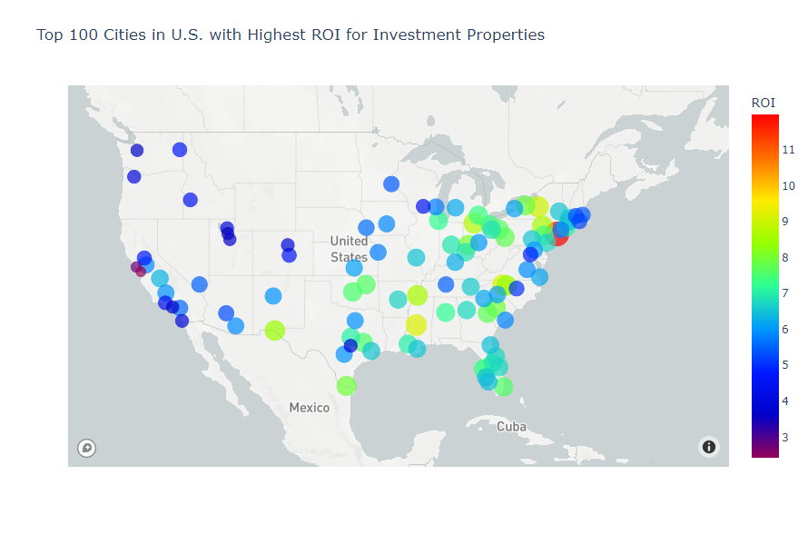
Data Analysis
Notes:
Go to Notebook to show longitude and latitude data

Slide 7
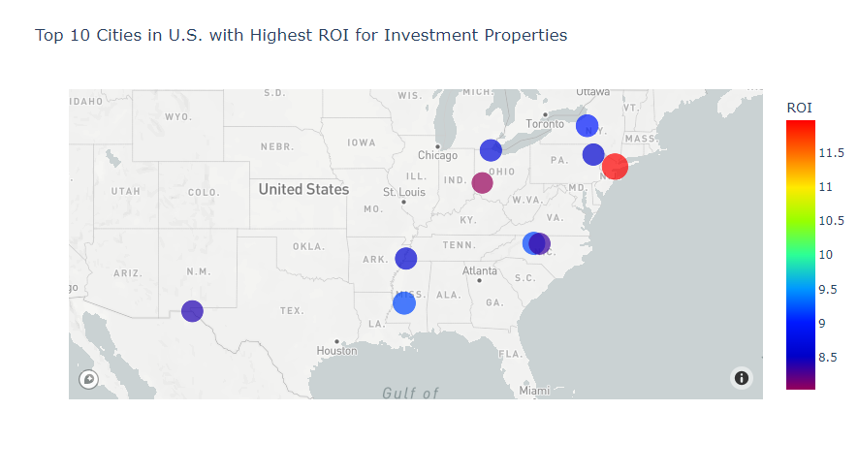
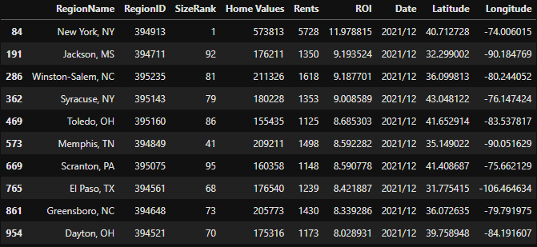

Data Analysis
Notes:
Go to Notebook to show bar graphs where you can click on the different groupby drop downs.

Slide 8
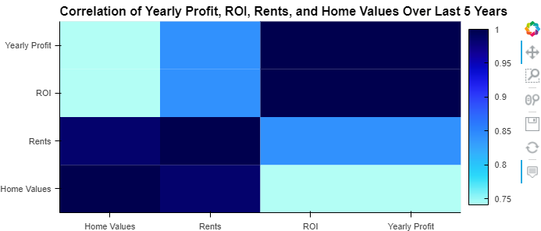
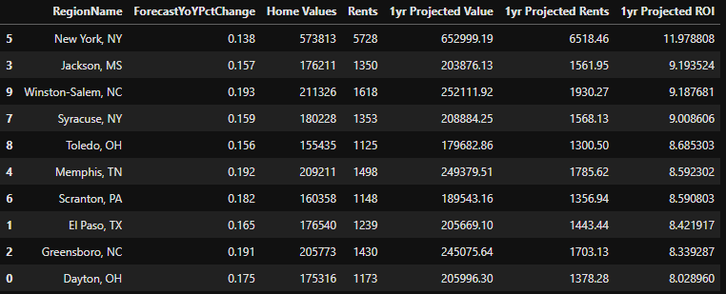
Projecting to the Future
We noticed the correlation between home values and rents was nearly 1 (0.98472). Since we were unable to run a Monte Carlo Simulation we used the assumption of a perfect correlation of 1, coupled with the projected home values 1 year from today (ZHVF), and calculated projected rents and ROI.
Using forecasted percent change and the assumed correlation of 1, projected values were calculated for rents. With projected home values and rents, ROI was able to be calculated.

Slide 9
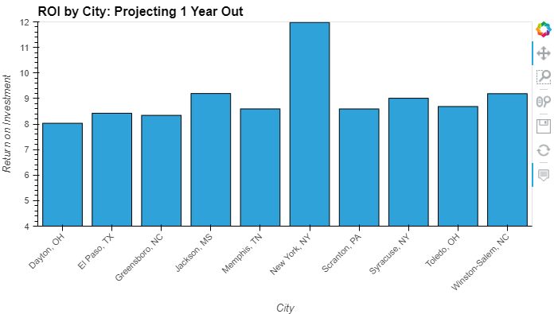
How does ROI look in the Future?
New York City, NY (11.97%)
Jackson, MS (9.19%)
Winston-Salem, NC (9.19%)
Syracuse, NY (9.01%)
Toledo, OH (8.69%)
Memphis, TN (8.59%)
Scranton, PA (8.59%)
El Paso, TX (8.42%)
Greensboro, NC (8.34%)
Dayton, OH (8.03%)

Slide 10

Postmortem
-Difficulties that arose:
Finding real estate data to use
Cleaning data and organizing
Plotting on maps with coordinates
Could not execute Monte Carlo Simulation with our real estate data
-Additional Questions that came up:
What other data would make it more accurate for investors?
-County taxes
-Insurance Costs
-Vacancy Rates
-Repair Costs
-Property Management
What is the best way to project into the future?
Would data taken by county have been better?

Slide 11

Q&A
Questions
Comments
Advice
Put-Downs

